Slide 1
Producers & Consumers
Mrs. Stone

Slide 2
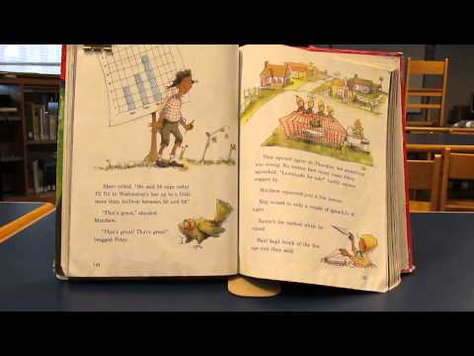
Lemonade for Sale by Stuart Murphy

Slide 3
Producer
A person that makes, grows, or supplies goods for sale.

Slide 4
Who were the producers in the story?

Slide 5
The members of the Elm Street Kids’ Club.

Slide 6
What did they produce?

Slide 7
Lemonade

Slide 8
Why did they sell lemonade?

Slide 9
To earn money to fix their club house.

Slide 10
Who bought the lemonade?

Slide 11
Other people (consumers)

Slide 12
Consumer
The person who purchases goods.

Slide 13
When you buy something, you are the consumer. As consumers we usually pay money for goods and services that we need.

Slide 14
Goods
Services
toys
ice cream
chocolate
xbox 360
skittles
video games
tv
wii
games
board games
Beauty Salon
Car Wash
Shoe Polisher
Vet Clinic
Doctor
Guitar Center
Babysitter
Pilot
Groomer
Dentist

Slide 15
Consumers and producers need each other so that products can be made and bought.

Slide 16
Goods
Merchandise or possessions

Slide 17
Services
The action of doing work for someone.

Slide 18
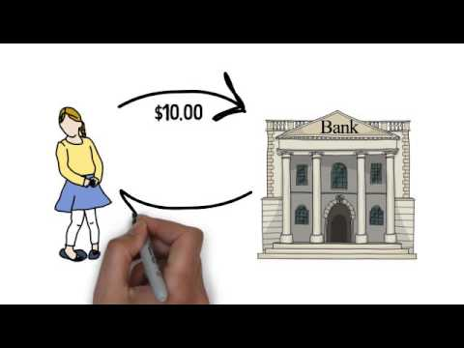
What is a bank?

Slide 19
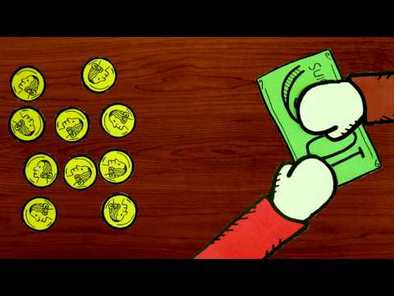
The Story of Money

Slide 20
Interest
If I loan you $10. I am going to charge you a 10% interest rate. 10% of $10 is $1. Therefore when you pay me back, you will pay me $11.
Borrowed: $10
Interest: $1
Total: $11

Slide 21
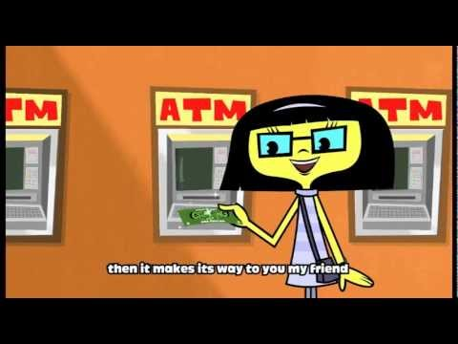
Cha-Ching: Earn, Spend, and Donate

